Slide 1
Emotion recognition from speech
BATCH -104
R. Sai kiran reddy - 190031440
A.R. Snehita - 190030059
N.SAI JYOTHI - 190031204

Slide 2

Contents
Jupyter Notebook – Is an Open-source, web-based UI for python projects.
Librosa – Is a Python library for analyzing audio and music.
Machine Learning Techniques:
MLP Classifier in ANN
XGBoost
Voting Classifier
1D Convolutional Neural Networks
Datasets:
RAVDESS Dataset
TESS Dataset

Slide 3

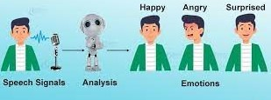
Abstract
What is Speech Emotion Recognition?
Emotion recognition is the part of speech recognition which is gaining more popularity and need for it increases enormously.
Speech Emotion Recognition, abbreviated as SER, is the act of attempting to recognize human emotion and affective states from speech. This is capitalizing on the fact that voice often reflects underlying emotion through tone and pitch.
As emotions play a vital role in communication, the detection and analysis of the same is of vital importance in today’s digital world of remote communication.

Slide 4

Data Sources
Here we will used two datasets there are: RAVDESS and TESS in addition to the data set we used in our midterm study. Models that we trained made prediction over these records.
TESS (Toronto Emotional Speech Set): 2 female speakers, 2800 audio files, random words and RAVDESS (Ryerson Audio-Visual Database of Emotional Speech and Song) we will use in our midterm study contains 1440 sound files that voiced by 24 actors.
Both of the data sets files in the form of .wav.
The RADVESS emotions includes calm, happy, sad, angry, fearful, surprised, neural and disgust. The TESS emotions includes RADVESS all emotions except calm.
In RADVESS file: ‘modality-vocalChannel-emotion-emotionallntensity-statement-repetition-actor.wav’. Eg: 03-01-06-01-02-01-12.wav.
In TESS file: ‘emotion_number.wav’. Eg: angry_1.wav.

Slide 5

Features used In this study
From the Audio data we have extracted the three key features which have been used in this study namely, MFCC (Mel Frequency Cepstral Coefficients), Mel Spectrogram and Chroma. The Python implementation of Librosa package will be used in their extraction.
Choice of features:
MFCC was by far the most researched about and utilized features in research papers and open source projects.
Mel spectrogram plots amplitude on frequency vs time graph on a “Mel” scale. As the project is on emotion recognition, a purely subjective item, we found it better to plot the ampulitude on Mel scale changes the record frequency to “perceived frequency”.
Chroma: Pertains to the 12 different pitch classes.

Slide 6
Feature extraction
The Speech signal contains a large number of parameters that reflect the emotional characteristics. One of the sticking points in emotion recognition is what features should be used. In recent research, many common features are extracted, such as energy, pitch, format, and some spectrum features such as Linear Prediction Coefficients (LPC), Mel-Frequency Cep-strum Coefficients(MFCC) and Modulation spectral features. In this work, we have selected Modulation spectral features and MCFF, to extract the emotional features.
Mel-Frequency Cepstrum coefficient is the most used representation of spectral property of voice signals.
These are the best for speech recognition as it takes human perception sensitivity with respect to frequencies to consideration.

Slide 7

Time construction
Speech time construction refers to the emotion speech pronunciation differences in time. When people express different feelings, the time construction of the speech is different.
Mainly in two aspects, one is the length of continuous pronunciation time, the other is the average rate of pronunciation.
One is the length of continuous pronunciation time and the other is the average rate of pronunciation.
In conclusion, if we extract the time construction characteristics parameters of the speech, it is easy to distinguish sad emotion from other emotional states.
Of course, we also can set a certain time threshold to distinguish joy, anger, surprise, and speech.

Slide 8
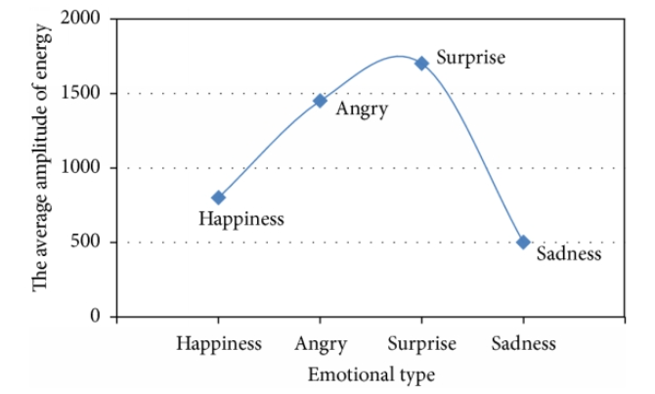
Amplitude construction
Speech signal amplitude construction and speech emotional state also have a direct link.
When the speaker is angry or happy, the volume of speech is generally high. When speaker is sad or depressed, the volume of speech is generally low.
Therefore, the analysis of speech emotion features of amplitude construction is more meaningful.
Is the comparison of emotional speech and calm speech, which is shown with average amplitude of difference.

Slide 9
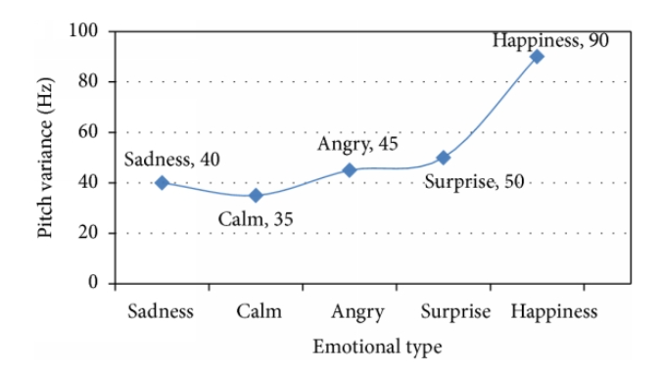
Fundamental frequency construction
If the emotions expressed were different, fundamental frequency were also different.
When the speaker is in a state of happiness, the fundamental frequency curve of speech generally is bent upwards.
And when the speaker is in a state of sadness, the fundamental frequency curve of speech generally is bent downward.

Slide 10
Preparation
We will used both data sets as one ‘train’ and one as ‘test’. As a result, we decided to combine the two data sets. We determined the sets of ‘train’ and ‘test’ by separating combined set randomly.
While making our emotion predictions, we have decided to try our models in two different approaches. First approach was to divide the emotions into two main groups in order to increase the accuracy and second one was to only train on 3 of the main emotions: Happy, Angry and Calm.
We going to be trained our models with all emotions expect ‘disgust’ and ‘neutral’ and they made their predictions accordingly.

Slide 11

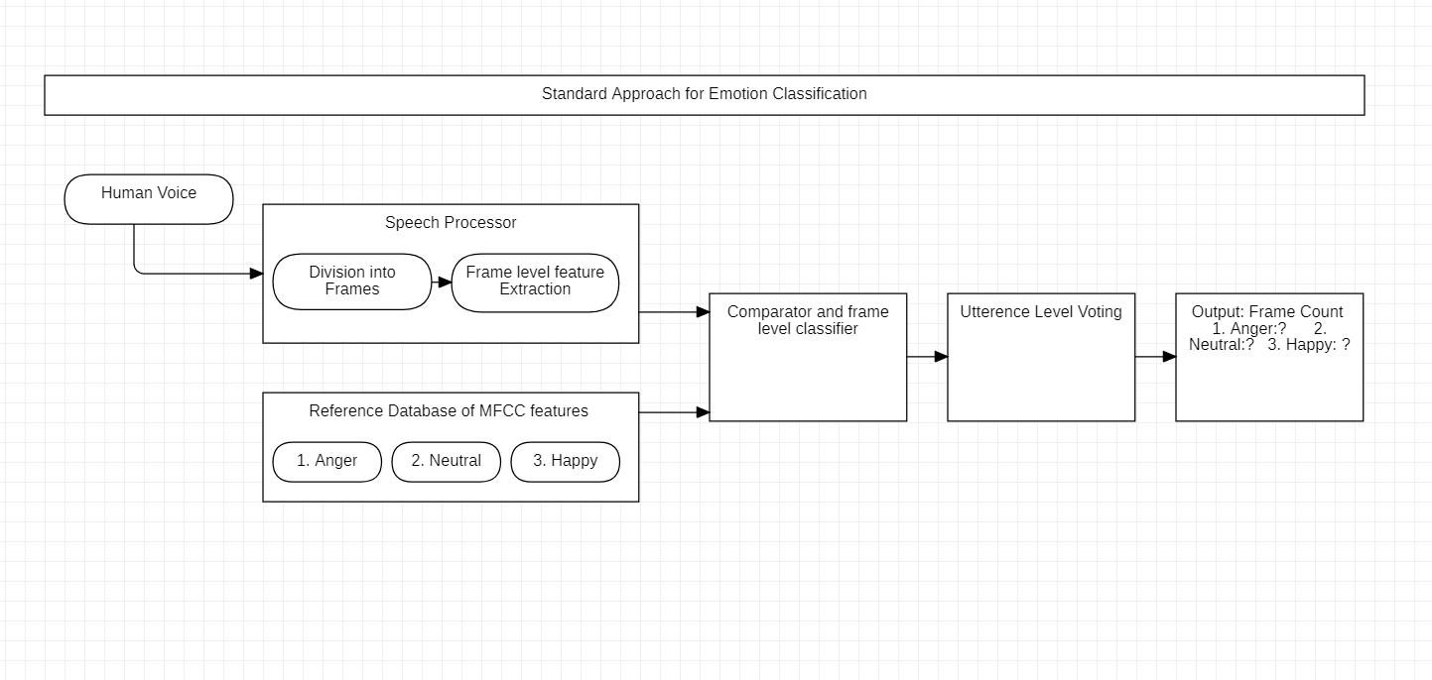
Workflow
A Statistical approach is followed taking pitch as feature for gender recognition. A lower and upper bound pitch for both male and female samples could be found using the reference database.
Input human voice sample was first broken down into frames of frame size 16 ms each. This was done for frame level classification in further steps.
For each frame MFCC(Mel Frequency Cepstral Coefficient) was calculated as the main feature for emotion recognition. In reference database which contains the MFCC’s of emotions of SAD, ANGER, NEUTRAL and HAPPY.

Slide 12


Conclusion & future work
In this project, the concept implemented was emotion recognition using MFCC approach. Going to be implemented using Support vector machine is used to classifying the gender in this work.
Speech classifier is based on the pitch analysis. MFCC approach for emotion recognition from speech is a stand-alone approach which does not require calculation of any other acoustic features and produce more accurate results.
The proposed models can be used for emotion-related applications such as conversational chatbots, social robots, etc. where identifying emotion and sentiment hidden in speech may play a role in the better conversation.

Slide 13
Benefits and advantages
Emotion recognition are a perfect fit for robot and human interaction and also can enlighten the concept of “Emotional Artificial Intelligence”.
Software can help doctors with the diagnosis of diseases such as depression and dementia by using voice analysis.
It can also show immense help in recruiting platform by the voice analysis during the interview and depict the credibility of the candidate.

Slide 14
Benefits and advantages (contd..)
This Emotion analysis can pair up with the AI speaker which are being installed in many homes and can respond with the respective mood accordingly.
An angry customer can be detected from the beginning and can be routed to a well-trained agent who can also monitor in real-time how the conversation is going and adjust. A very useful tactic that can help in the service providence.
Counselling and determining client’s medical state
During healthcare, determining patients feeling and comfort level about the treatment emotion detection can play a massive role as it requires less human effort and can be accurate.

Slide 15

References used to prepare the technical content of Emotion recognition from speech- 1
Alessandro Ragano, Emmanouil Benetos, and Andrew Hines “Development of a speech quality database under uncontrolled conditions,” in Proc. Interspeech 2021.
P C Loizou, “Speech quality assessment,” Multimedia analysis, processing and communications, 2011.
Yi Hu and Philipos C. Loizou, “Evaluation of objective quality measures for speech enhancement,” IEEE Transactions on Audio, Speech, and Language Processing, Vol. 16, No. 1, January 2008.
Alex, G. and Navdeep, J. (2014). Towards end-to-End Speech Recognition with Recurrent Neural Networks. International Conference on Machine Learning,32.
AasthaJoshi “Speech Emotion Recognition Using Combined Features of HMM & SVM Algorithm”, National Conference on August 2013.
Chiu Ying Lay, Ng Hian James. “Gender Classification from Speech”, (2005).

Slide 16
References used to prepare the technical content of Emotion recognition from speech- 2
Fayek, H. M., Lech, M., and Cavedon, L.(2017). Evaluating deep learning architectures for speech emotion recognition. Neural Netw. 92, 60-68. doi:10.1016/j.neunet.2017.02.013.
Lee, J. Tashev, I: High-level feature representation using recurrent neural network for speech emotion recognition. In: INTERSPEECH (2015).
Z. Yongzhao and C. Peng, “Research and implementation of emotional feature extraction and recognition in speech signal”, Joural of Jiangsu University, vol. 26. no. 1, pp. 72-75, 2005.
T. Banziger and K. R. Scherer, “The role of intonation in emotional expressions,” Speech Communication, vol. 46, no. 3-4, pp. 252-267, 2005.

Slide 17



